Slide 1
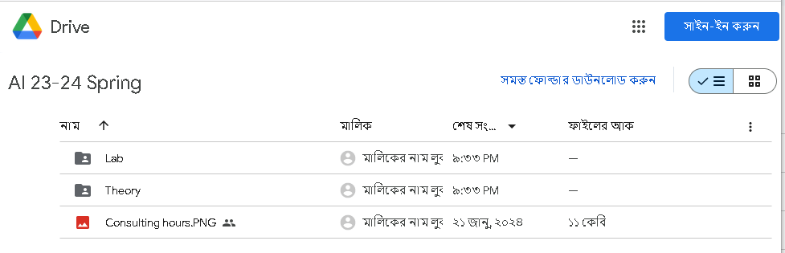
Click on Sign In

Slide 2
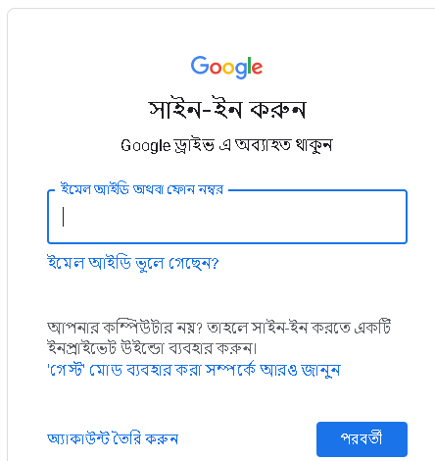
Log in to Google Drive using your Gmail credentials

Slide 3
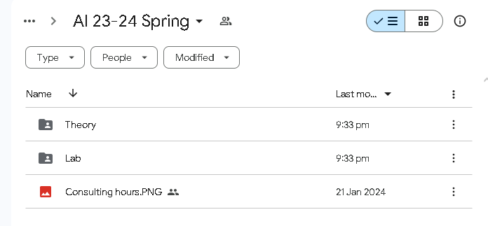
Go to Lab Folder

Slide 4
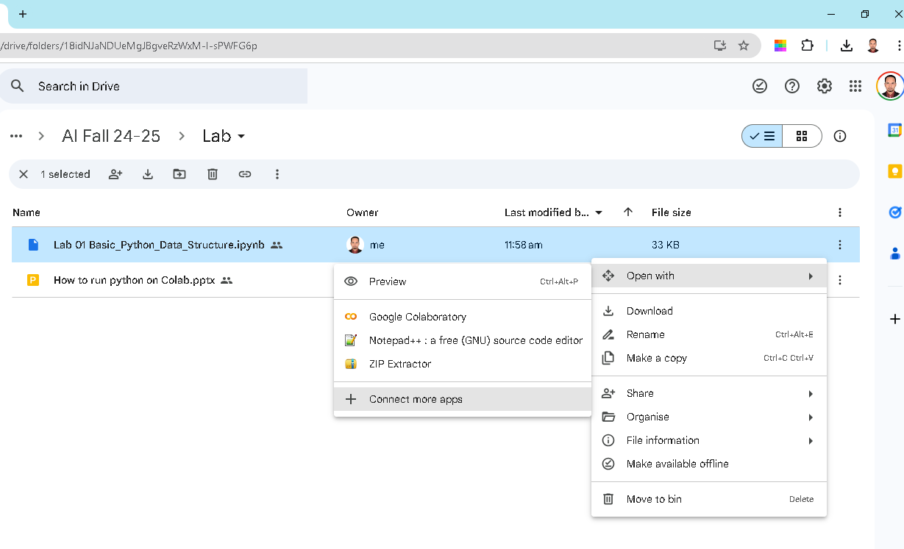
Install Collaboratory
Open with -> connect more apps
Search Colaboratory and install

Slide 5
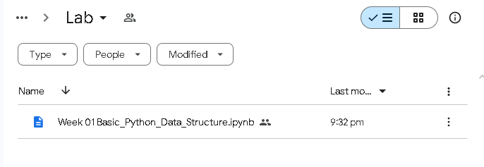
Double Click to open the file

Slide 6
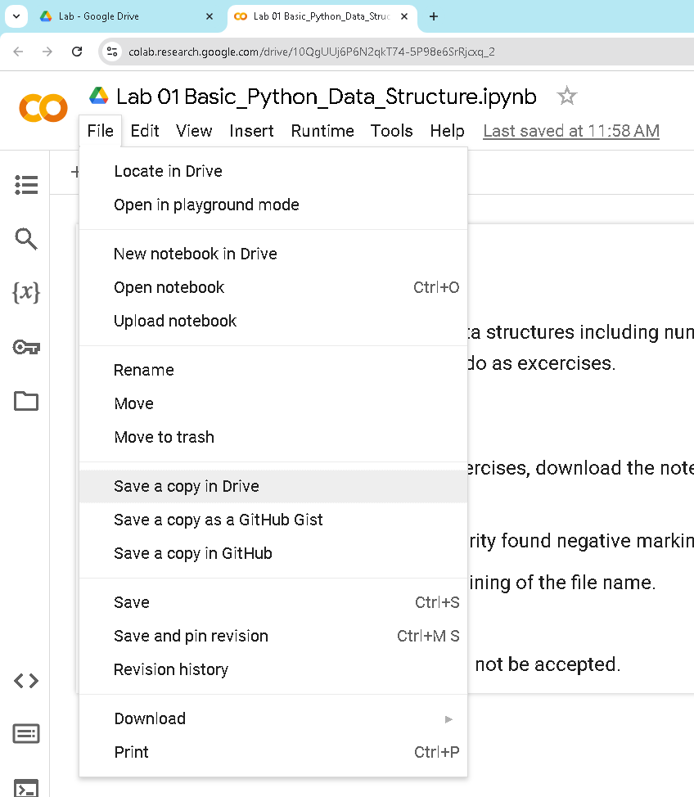
Copy to Drive from File menu

Slide 7
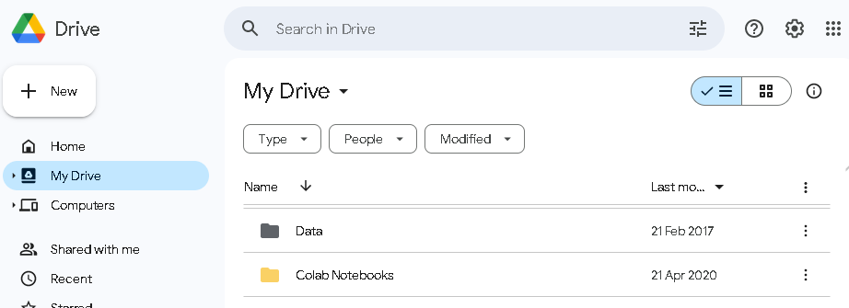
Go to your Google Drive home and Click the folder
Here, your file will be saved automatically

Slide 8
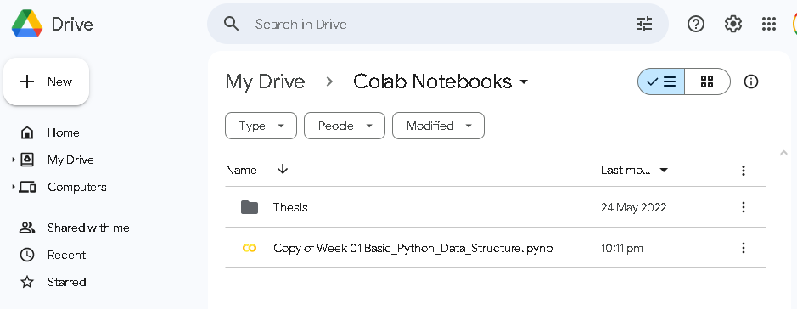
Double Click then the file will open in new tab
Close all windows and open this file. The changes will be saved automatically. You can access the file from any device and code.

Slide 9
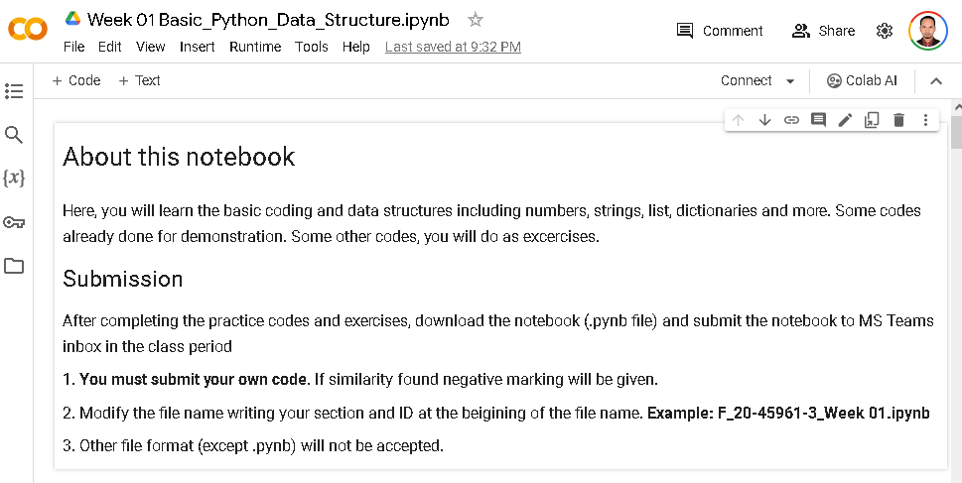
Rename the file, Connect and Complete Code
20-45961-3 Lab 01.ipynb

Slide 10
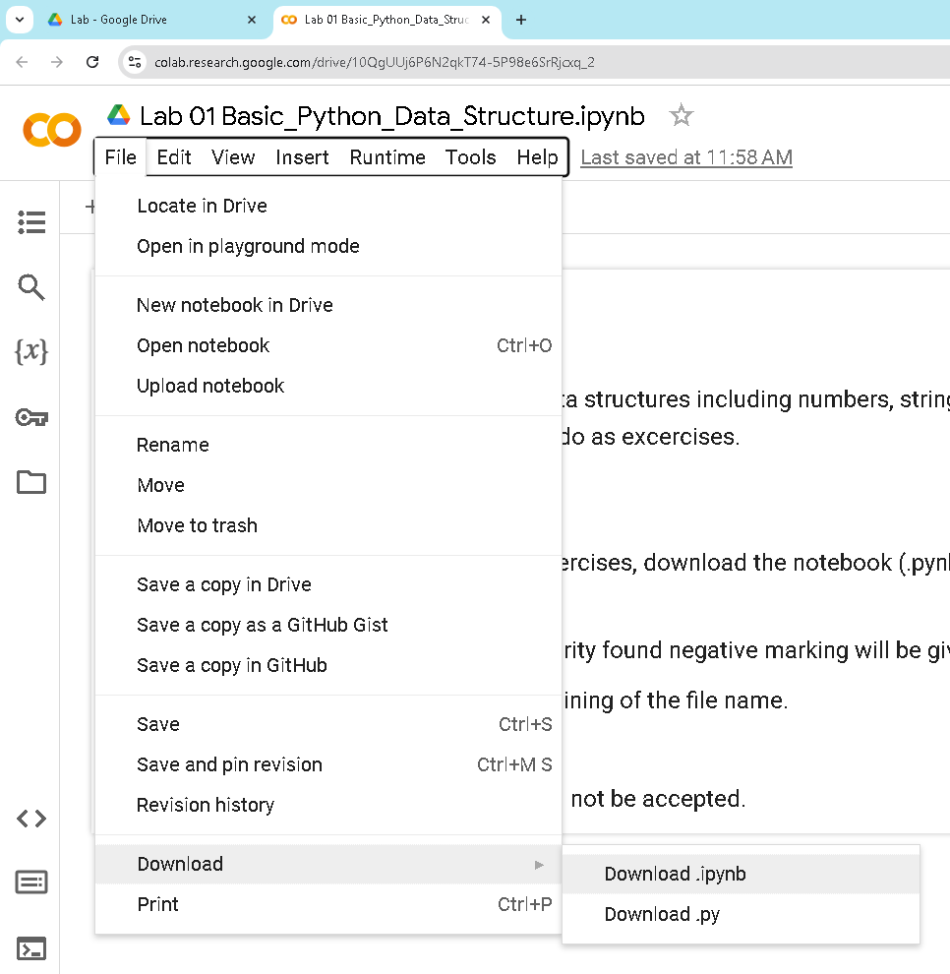
Download the file
send to MS Teams inbox

